Slide 1
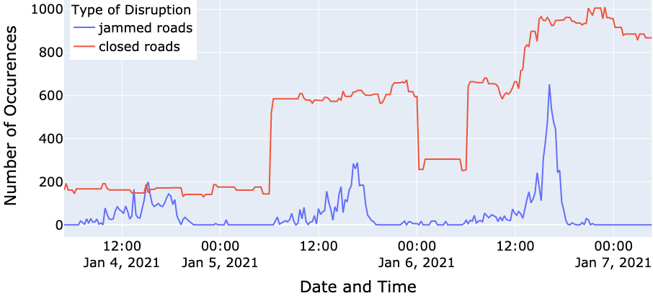
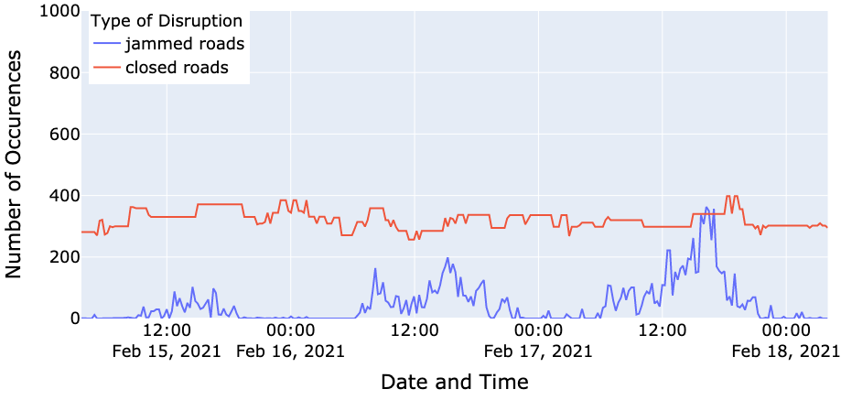
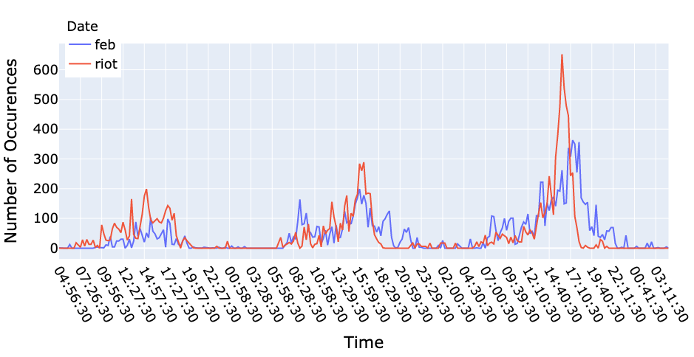
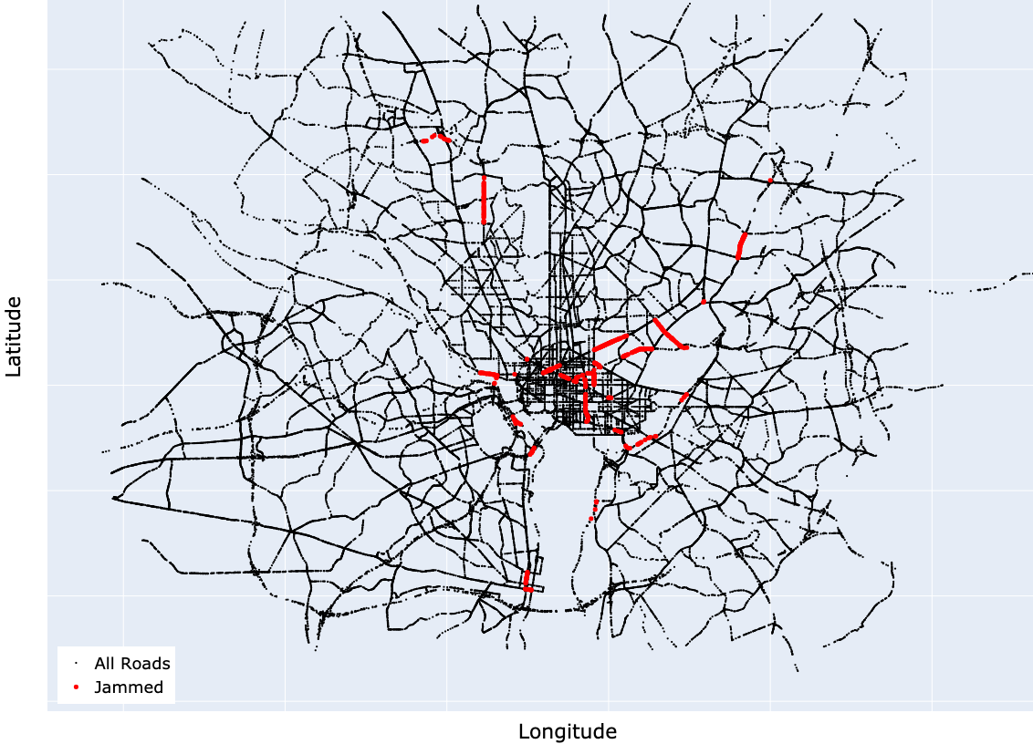
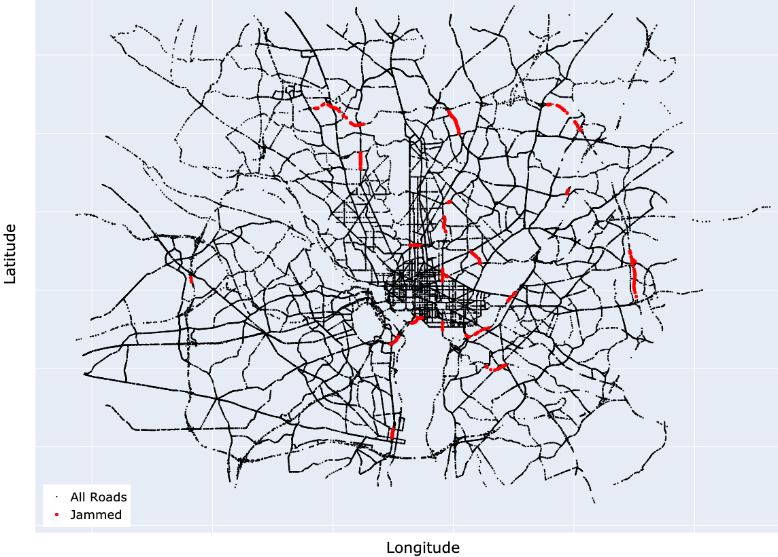
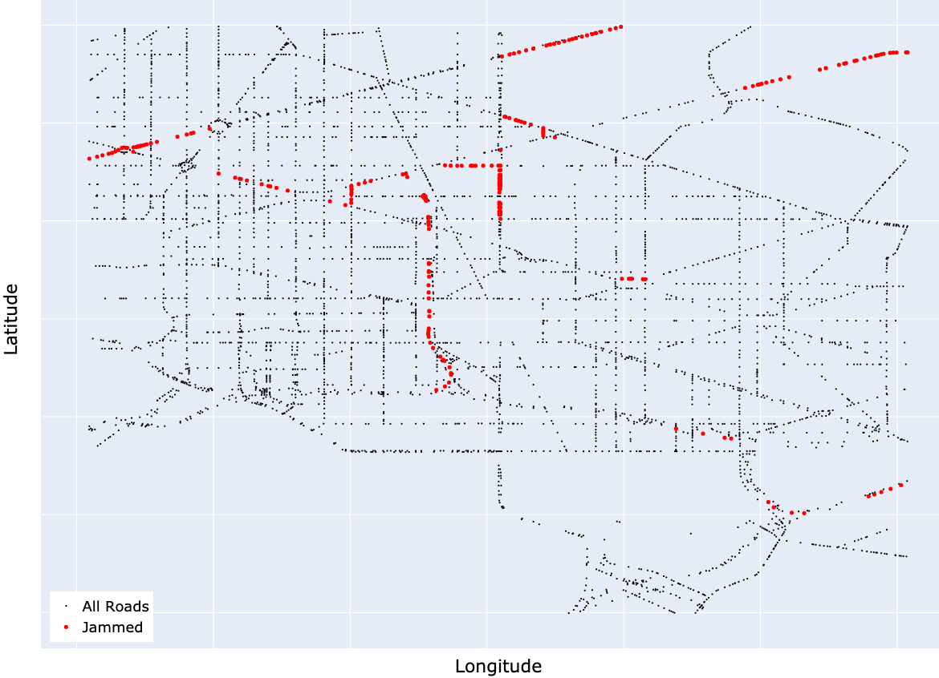
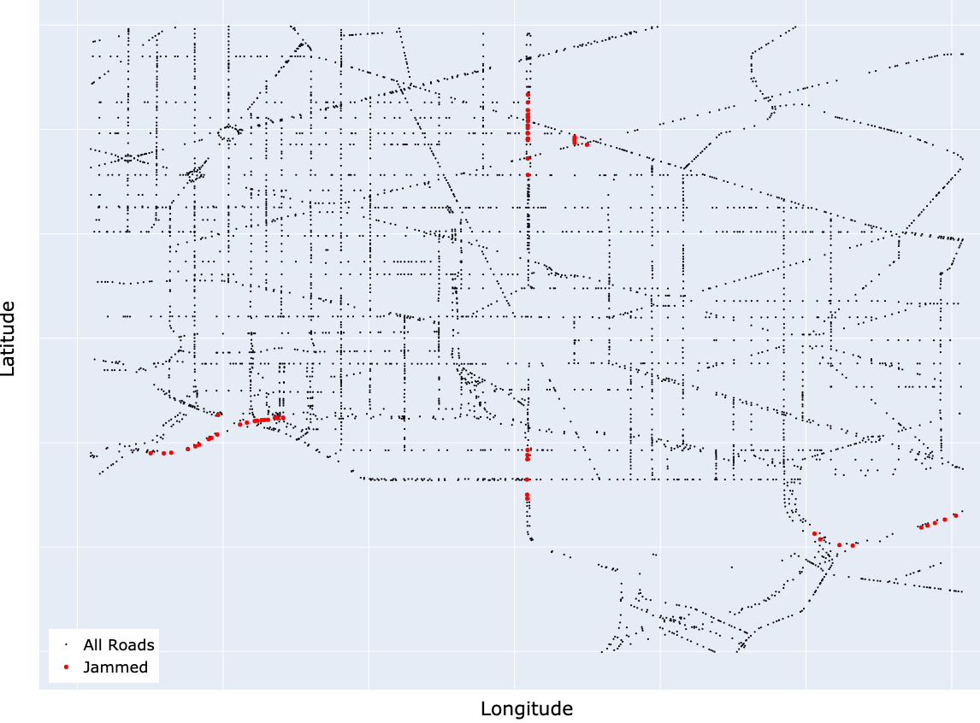
A Spatial-Temporal Analysis of Real-Time Washington D.C. Traffic
Hannah Conner & Skanda Vivek, Ph.D.
Georgia Gwinnett College
Introduction
Results
Results
The planned protest on January 6, 2021, of the certification of the 2020 United States Presidential Election turned into a violent insurrection at the United States Capitol. This paper analyzes how these riots affected the traffic both in a close proximity to the capitol and in the greater D.C. area throughout the week of January 6. This paper studies where and when traffic was most affected by this major event. We used a REST API from HERE technologies to scrape the real-time traffic data in the greater Washington D.C. area during the week of January 6. The traffic data was examined on a daily and hourly basis to compare the differences throughout the week and detect the anomalies this caused in the traffic patterns of the city. We also examined a smaller subset of the data within a close proximity to the capitol and compared the results to the greater D.C. area. All of these findings were compared to more typical week of traffic data taken from the week of February 15, 2021 to determine the major disruptions caused by the riots compared with the typical traffic problems in the city. This can be used to help emergency personnel adjust when a major event causes severe traffic disruption.
Figure 1
The number of closed and jammed roads during week of the riot.
Figure 2
The number of closed and jammed roads during week in February.
Figure 7
Number of traffic jams during the week of riot and February
Conclusion
When looking at all the data collection points at 16:30 on Wednesday the highest concentration of jams in January is near the capitol. When looking at the same day and time in February we can see there are less traffic disruptions near the capitol.
During the Capitol riots we can see a significant jump in traffic disruptions at around 16:30 p.m. on Wednesday. While we also see a significant jump at the same time and day in February it is half of the amount of traffic disruption that occurred during the riot.
We can see a sustained increase in road closures in February as a result of increased security after the riot occurred.
As the number of road closures increases the number of traffic jams also increases in both weeks.
As expected, there is an increasing number of traffic disruptions during the evening rush hour as each week progresses.
Methodology
Figure 3
Plot of where the traffic jams occurred at 16:30 on the day of the riot.
Figure 4
Plot of where the traffic jams occurred at 16:30 on Wednesday in February.
Using a RESTful API from HERE Technologies we gathered real-time traffic data from the greater Washington D.C. area and performed a spatial-temporal analysis in python. Each node in the data set is associated with a latitude and longitude pair and has several different variables. For this study we focused on jam factor, free flow, and speed uncut. Jam factor is a measure of how jammed a node is determined to be on a scale from 0 to 10 with 0 being a free-flowing road and 10 a closed road. Free flow is the current speed at a given node. Speed uncut is the average speed driven not adjusting for the speed limit. Closed roads are those with a jam factor of 10 and jammed roads are those with a jam factor less than 10 and greater than or equal to 8.
Future Work
Compare the traffic flow to what was found from the traffic jams and see how closely related the two variables are.
Incorporate closed road information from the city of Washington D.C. to determine if the closed roads are closed or severely jammed.
Determine which roads can be clustered together based on either flow or jam data.
Figure 5
Look at traffic jams near capitol during the riot at 16:30 p.m.
Figure 6
Look at jams near capitol at 16:30 p.m. on Wednesday in February.

